Slide 1
Bootstrap Navigation Bars
廖向德

Slide 2
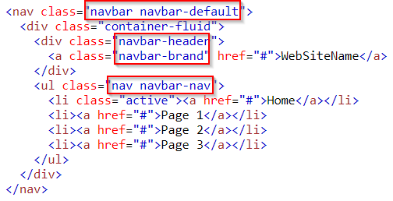
Navigation Bar
Example
Notes:
<!DOCTYPE html>
<html lang="en">
<head>
<title>Bootstrap Example</title>
<meta charset="utf-8">
<meta name="viewport" content="width=device-width, initial-scale=1">
<link rel="stylesheet" href="https://maxcdn.bootstrapcdn.com/bootstrap/3.3.7/css/bootstrap.min.css">
<script src="https://ajax.googleapis.com/ajax/libs/jquery/3.2.1/jquery.min.js"></script>
<script src="https://maxcdn.bootstrapcdn.com/bootstrap/3.3.7/js/bootstrap.min.js"></script>
</head>
<body>
<nav class="navbar navbar-default">
<div class="container-fluid">
<div class="navbar-header">
<a class="navbar-brand" href="#">WebSiteName</a>
</div>
<ul class="nav navbar-nav">
<li class="active"><a href="#">Home</a></li>
<li><a href="#">Page 1</a></li>
<li><a href="#">Page 2</a></li>
<li><a href="#">Page 3</a></li>
</ul>
</div>
</nav>
<div class="container">
<h3>Basic Navbar Example</h3>
<p>A navigation bar is a navigation header that is placed at the top of the page.</p>
</div>
</body>
</html>

Slide 3
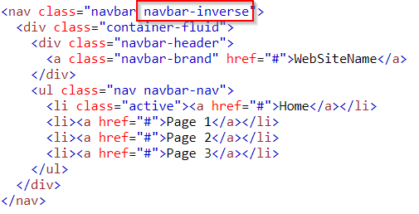
Inverted Navigation Bar
change the .navbar-default class into .navbar-inverse Example
Notes:
<!DOCTYPE html>
<html lang="en">
<head>
<title>Bootstrap Example</title>
<meta charset="utf-8">
<meta name="viewport" content="width=device-width, initial-scale=1">
<link rel="stylesheet" href="https://maxcdn.bootstrapcdn.com/bootstrap/3.3.7/css/bootstrap.min.css">
<script src="https://ajax.googleapis.com/ajax/libs/jquery/3.2.1/jquery.min.js"></script>
<script src="https://maxcdn.bootstrapcdn.com/bootstrap/3.3.7/js/bootstrap.min.js"></script>
</head>
<body>
<nav class="navbar navbar-inverse">
<div class="container-fluid">
<div class="navbar-header">
<a class="navbar-brand" href="#">WebSiteName</a>
</div>
<ul class="nav navbar-nav">
<li class="active"><a href="#">Home</a></li>
<li><a href="#">Page 1</a></li>
<li><a href="#">Page 2</a></li>
<li><a href="#">Page 3</a></li>
</ul>
</div>
</nav>
<div class="container">
<h3>Inverted Navbar</h3>
<p>An inverted navbar is black instead of gray.</p>
</div>
</body>
</html>

Slide 4
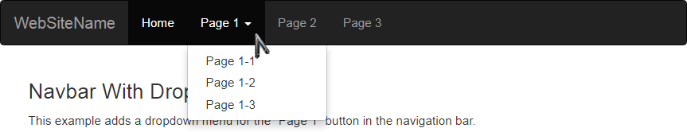
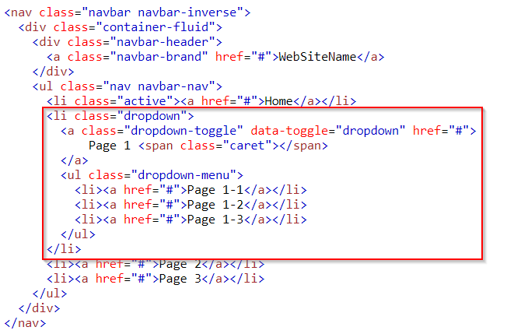
Navigation Bar With Dropdown
Example
Notes:
<!DOCTYPE html>
<html lang="en">
<head>
<title>Bootstrap Example</title>
<meta charset="utf-8">
<meta name="viewport" content="width=device-width, initial-scale=1">
<link rel="stylesheet" href="https://maxcdn.bootstrapcdn.com/bootstrap/3.3.7/css/bootstrap.min.css">
<script src="https://ajax.googleapis.com/ajax/libs/jquery/3.2.1/jquery.min.js"></script>
<script src="https://maxcdn.bootstrapcdn.com/bootstrap/3.3.7/js/bootstrap.min.js"></script>
</head>
<body>
<nav class="navbar navbar-inverse">
<div class="container-fluid">
<div class="navbar-header">
<a class="navbar-brand" href="#">WebSiteName</a>
</div>
<ul class="nav navbar-nav">
<li class="active"><a href="#">Home</a></li>
<li class="dropdown">
<a class="dropdown-toggle" data-toggle="dropdown" href="#">
Page 1 <span class="caret"></span>
</a>
<ul class="dropdown-menu">
<li><a href="#">Page 1-1</a></li>
<li><a href="#">Page 1-2</a></li>
<li><a href="#">Page 1-3</a></li>
</ul>
</li>
<li><a href="#">Page 2</a></li>
<li><a href="#">Page 3</a></li>
</ul>
</div>
</nav>
<div class="container">
<h3>Navbar With Dropdown</h3>
<p>This example adds a dropdown menu for the "Page 1" button in the navigation bar.</p>
</div>
</body>
</html>

Slide 5
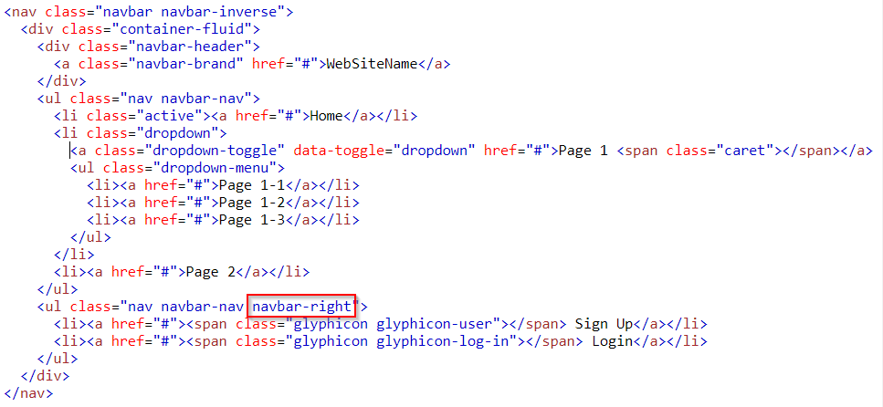
Right-Aligned Navigation Bar
Example
Notes:
<!DOCTYPE html>
<html lang="en">
<head>
<title>Bootstrap Example</title>
<meta charset="utf-8">
<meta name="viewport" content="width=device-width, initial-scale=1">
<link rel="stylesheet" href="https://maxcdn.bootstrapcdn.com/bootstrap/3.3.7/css/bootstrap.min.css">
<script src="https://ajax.googleapis.com/ajax/libs/jquery/3.2.1/jquery.min.js"></script>
<script src="https://maxcdn.bootstrapcdn.com/bootstrap/3.3.7/js/bootstrap.min.js"></script>
</head>
<body>
<nav class="navbar navbar-inverse">
<div class="container-fluid">
<div class="navbar-header">
<a class="navbar-brand" href="#">WebSiteName</a>
</div>
<ul class="nav navbar-nav">
<li class="active"><a href="#">Home</a></li>
<li class="dropdown">
<a class="dropdown-toggle" data-toggle="dropdown" href="#">Page 1 <span class="caret"></span></a>
<ul class="dropdown-menu">
<li><a href="#">Page 1-1</a></li>
<li><a href="#">Page 1-2</a></li>
<li><a href="#">Page 1-3</a></li>
</ul>
</li>
<li><a href="#">Page 2</a></li>
</ul>
<ul class="nav navbar-nav navbar-right">
<li><a href="#"><span class="glyphicon glyphicon-user"></span> Sign Up</a></li>
<li><a href="#"><span class="glyphicon glyphicon-log-in"></span> Login</a></li>
</ul>
</div>
</nav>
<div class="container">
<h3>Right Aligned Navbar</h3>
<p>The .navbar-right class is used to right-align navigation bar buttons.</p>
</div>
</body>
</html>

Slide 6
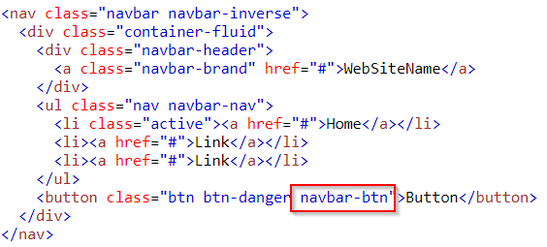
Navbar Buttons
Example
Notes:
<!DOCTYPE html>
<html lang="en">
<head>
<title>Bootstrap Example</title>
<meta charset="utf-8">
<meta name="viewport" content="width=device-width, initial-scale=1">
<link rel="stylesheet" href="https://maxcdn.bootstrapcdn.com/bootstrap/3.3.7/css/bootstrap.min.css">
<script src="https://ajax.googleapis.com/ajax/libs/jquery/3.2.1/jquery.min.js"></script>
<script src="https://maxcdn.bootstrapcdn.com/bootstrap/3.3.7/js/bootstrap.min.js"></script>
</head>
<body>
<nav class="navbar navbar-inverse">
<div class="container-fluid">
<div class="navbar-header">
<a class="navbar-brand" href="#">WebSiteName</a>
</div>
<ul class="nav navbar-nav">
<li class="active"><a href="#">Home</a></li>
<li><a href="#">Link</a></li>
<li><a href="#">Link</a></li>
</ul>
<button class="btn btn-danger navbar-btn">Button</button>
</div>
</nav>
<div class="container">
<h2>Navbar Button</h2>
<p>Use the navbar-btn class on a button to vertically align (same padding as links) it inside the navbar.</p>
</div>
</body>
</html>

Slide 7
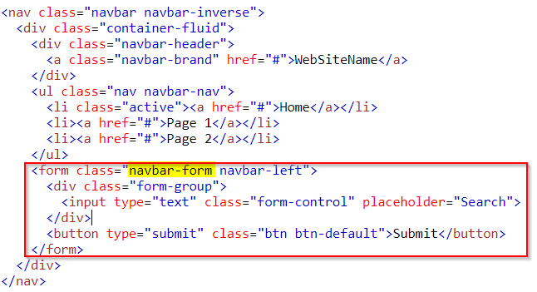
Navbar Forms
Example
Notes:
<!DOCTYPE html>
<html lang="en">
<head>
<title>Bootstrap Example</title>
<meta charset="utf-8">
<meta name="viewport" content="width=device-width, initial-scale=1">
<link rel="stylesheet" href="https://maxcdn.bootstrapcdn.com/bootstrap/3.3.7/css/bootstrap.min.css">
<script src="https://ajax.googleapis.com/ajax/libs/jquery/3.2.1/jquery.min.js"></script>
<script src="https://maxcdn.bootstrapcdn.com/bootstrap/3.3.7/js/bootstrap.min.js"></script>
</head>
<body>
<nav class="navbar navbar-inverse">
<div class="container-fluid">
<div class="navbar-header">
<a class="navbar-brand" href="#">WebSiteName</a>
</div>
<ul class="nav navbar-nav">
<li class="active"><a href="#">Home</a></li>
<li><a href="#">Page 1</a></li>
<li><a href="#">Page 2</a></li>
</ul>
<form class="navbar-form navbar-left">
<div class="form-group">
<input type="text" class="form-control" placeholder="Search">
</div>
<button type="submit" class="btn btn-default">Submit</button>
</form>
</div>
</nav>
<div class="container">
<h3>Navbar Forms</h3>
<p>Use the .navbar-form class to vertically align form elements (same padding as links) inside the navbar.</p>
</div>
</body>
</html>

Slide 8
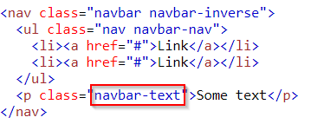
Navbar Text
Use the .navbar-text class to vertical align any elements inside the navbar that are not links (ensures proper padding and text color). Example
Notes:
<!DOCTYPE html>
<html lang="en">
<head>
<title>Bootstrap Example</title>
<meta charset="utf-8">
<meta name="viewport" content="width=device-width, initial-scale=1">
<link rel="stylesheet" href="https://maxcdn.bootstrapcdn.com/bootstrap/3.3.7/css/bootstrap.min.css">
<script src="https://ajax.googleapis.com/ajax/libs/jquery/3.2.1/jquery.min.js"></script>
<script src="https://maxcdn.bootstrapcdn.com/bootstrap/3.3.7/js/bootstrap.min.js"></script>
</head>
<body>
<nav class="navbar navbar-inverse">
<ul class="nav navbar-nav">
<li><a href="#">Link</a></li>
<li><a href="#">Link</a></li>
</ul>
<p class="navbar-text">Some text</p>
</nav>
<div class="container">
<h3>Navbar Text</h3>
<p>Use the .navbar-text class to vertical align any elements inside the navbar that are not links (ensures proper padding).</p>
</div>
</body>
</html>

Slide 9
Fixed Navigation Bar
A fixed navigation bar stays visible in a fixed position (top or bottom) independent of the page scroll.
The .navbar-fixed-top class makes the navigation bar fixed at the top Example
The .navbar-fixed-bottom class makes the navigation bar stay at the bottom Example

Slide 10
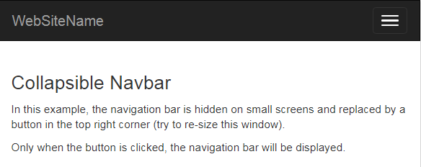
Collapsing The Navigation Bar (1/2)
The navigation bar takes up too much space on a small screen.
We should hide the navigation bar; and only show it when it is needed.
Example
Notes:
<!DOCTYPE html>
<html lang="en">
<head>
<title>Bootstrap Example</title>
<meta charset="utf-8">
<meta name="viewport" content="width=device-width, initial-scale=1">
<link rel="stylesheet" href="https://maxcdn.bootstrapcdn.com/bootstrap/3.3.7/css/bootstrap.min.css">
<script src="https://ajax.googleapis.com/ajax/libs/jquery/3.2.1/jquery.min.js"></script>
<script src="https://maxcdn.bootstrapcdn.com/bootstrap/3.3.7/js/bootstrap.min.js"></script>
</head>
<body>
<nav class="navbar navbar-inverse">
<div class="container-fluid">
<div class="navbar-header">
<button type="button" class="navbar-toggle" data-toggle="collapse" data-target="#myNavbar">
<span class="icon-bar"></span>
<span class="icon-bar"></span>
<span class="icon-bar"></span>
</button>
<a class="navbar-brand" href="#">WebSiteName</a>
</div>
<div class="collapse navbar-collapse" id="myNavbar">
<ul class="nav navbar-nav">
<li class="active"><a href="#">Home</a></li>
<li class="dropdown">
<a class="dropdown-toggle" data-toggle="dropdown" href="#">Page 1 <span class="caret"></span></a>
<ul class="dropdown-menu">
<li><a href="#">Page 1-1</a></li>
<li><a href="#">Page 1-2</a></li>
<li><a href="#">Page 1-3</a></li>
</ul>
</li>
<li><a href="#">Page 2</a></li>
<li><a href="#">Page 3</a></li>
</ul>
<ul class="nav navbar-nav navbar-right">
<li><a href="#"><span class="glyphicon glyphicon-user"></span> Sign Up</a></li>
<li><a href="#"><span class="glyphicon glyphicon-log-in"></span> Login</a></li>
</ul>
</div>
</div>
</nav>
<div class="container">
<h3>Collapsible Navbar</h3>
<p>In this example, the navigation bar is hidden on small screens and replaced by a button in the top right corner (try to re-size this window).
<p>Only when the button is clicked, the navigation bar will be displayed.</p>
</div>
</body>
</html>

Slide 11
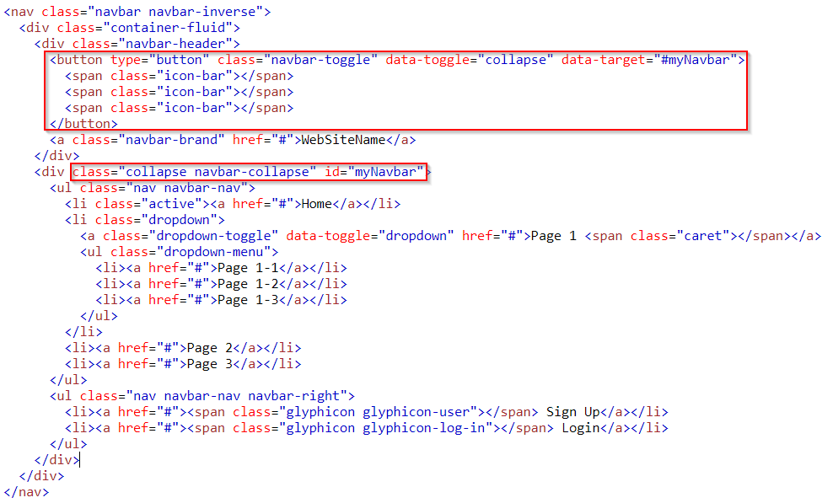
Collapsing The Navigation Bar (2/2)

